Slide 1

Air Quality Monitoring Dashboard
Using Real-Time Data from the WAQI API

Slide 2
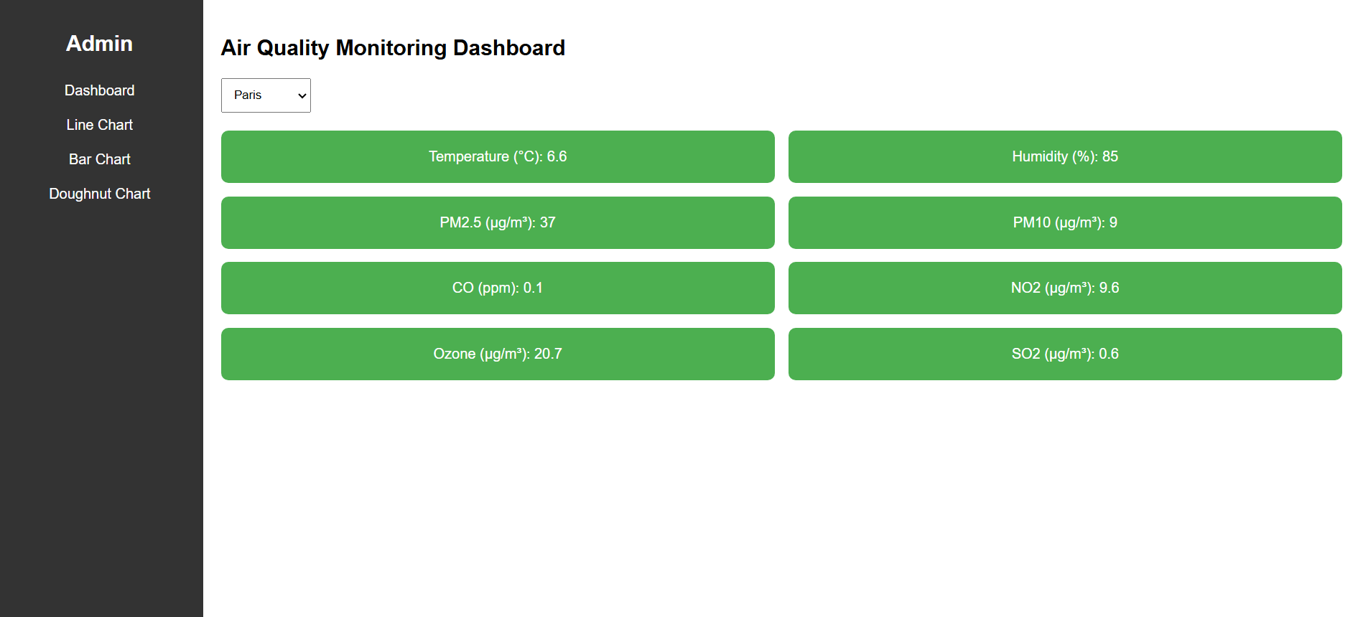
Project Overview
The project monitors real-time air quality metrics using WAQI API.
Visualizes :
Temperature (°C)
Humidity (%)
PM2.5 (µg/m³)
PM10 (µg/m³)
NOx (ppb)
NH3 (ppb)
CO2 (ppm)
SO2 (ppb)
VOC (ppb)
Dashboard displays:
Key data in styled cards.
Interactive charts to explore trends and distribution.
All code is modular, with separate HTML, CSS, and JavaScript files.

Slide 3
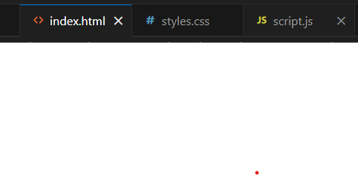
Folder and File Structure
Organized into three main files:
index.html: Defines the interface layout and structure.
styles.css: Manages the appearance and layout styling.
script.js: Fetches data and creates interactive features.
Simple and maintainable structure.

Slide 4
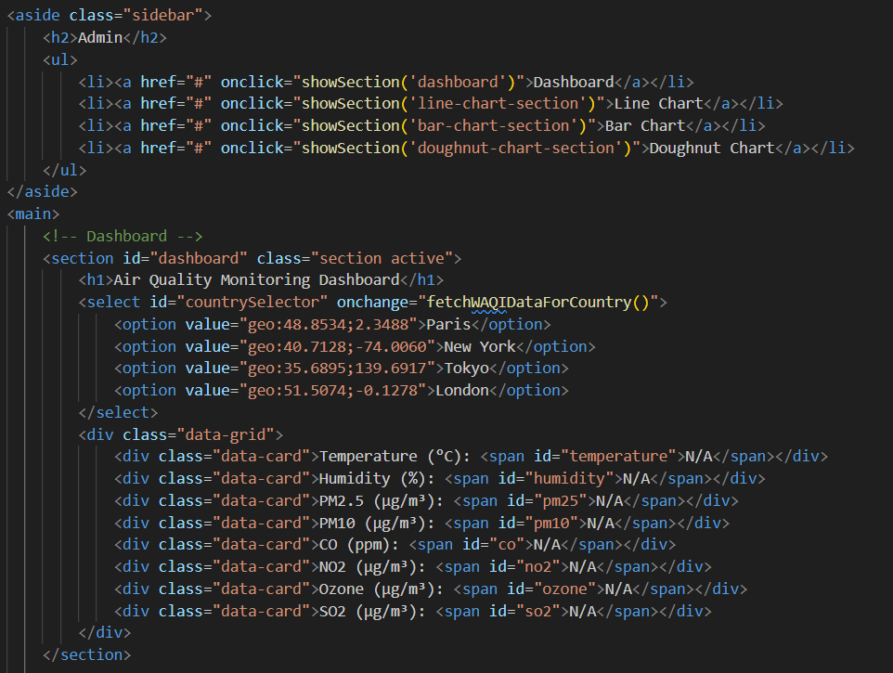
User Interface (HTML)
The interface has two key parts:
Sidebar:
Navigation links for Dashboard, Line Chart, Bar Chart, and Doughnut Chart.
Styled using CSS for alignment and hover effects.
Data-Grid Area:
Displays data metrics and visualizations.
HTML provides placeholders for the charts and dynamic cards.

Slide 5
Explication of the above code
Contains links for navigation:
Dashboard.
Line Chart.
Bar Chart.
Doughnut Chart.
Clicking these links calls a JavaScript function showSection() to show the corresponding section.
Main Content:
Displays the data and charts.
Dashboard Section:
Includes cards for ▪ Temperature (°C) ▪ Humidity (%) ▪ PM2.5 (µg/m³) ▪ PM10 (µg/m³) ▪ NOx (ppb) ▪ NH3 (ppb) ▪ CO2 (ppm) ▪ SO2 (ppb) ▪ VOC (ppb)
Each card has a span with an id (e.g., id="temperature") where data is dynamically updated by JavaScript.

Slide 6
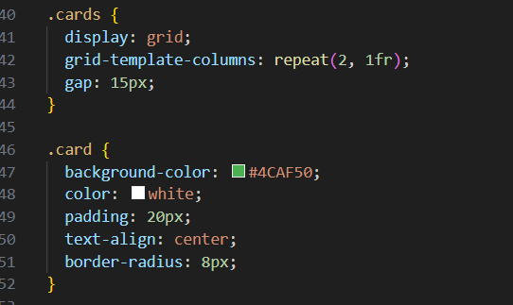
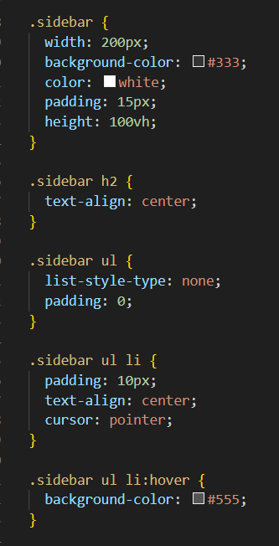
Styling with CSS
Sidebar:
Set background color and spacing for menu items.
Added hover effects for better navigation feedback.
Dashboard:
Cards styled with padding, background color, and border radius for a clean look.
Responsive Design:
Grid layout adapts for different screen sizes.

Slide 7
Explication
Sidebar Styling:
Gives the sidebar a fixed width, background color, and white text.
Adds hover effects on the menu items for better interaction.
Card Styling:
Arranges cards in a grid layout.
Adds spacing (gap) between cards.
Uses rounded corners and background color for a clean, modern look.

Slide 8
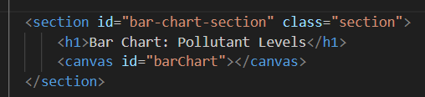
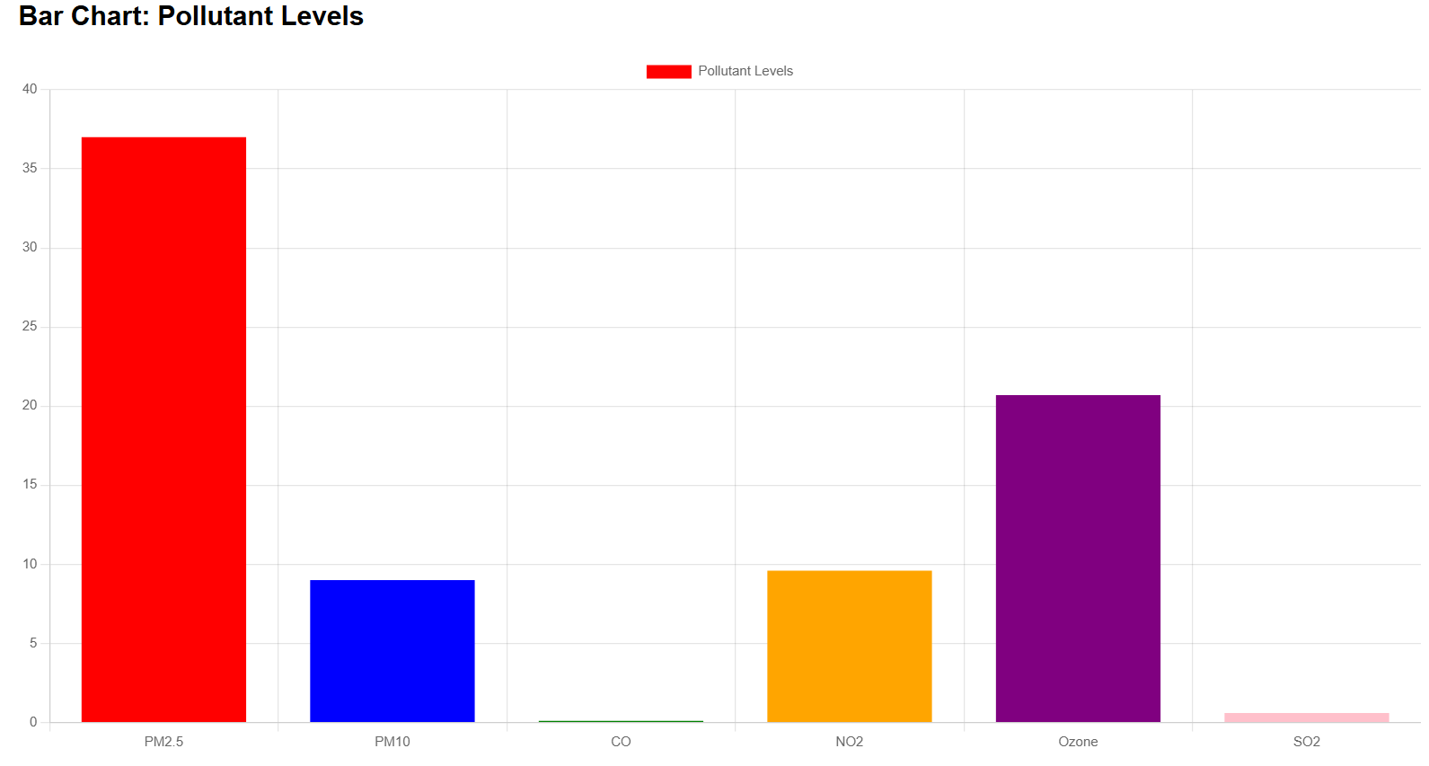
Comparing Pollutants: Bar Chart
Compares PM2.5 and PM10 levels.
Chart.js used for visualization.
Clear comparison with distinct bar colors.

Slide 9

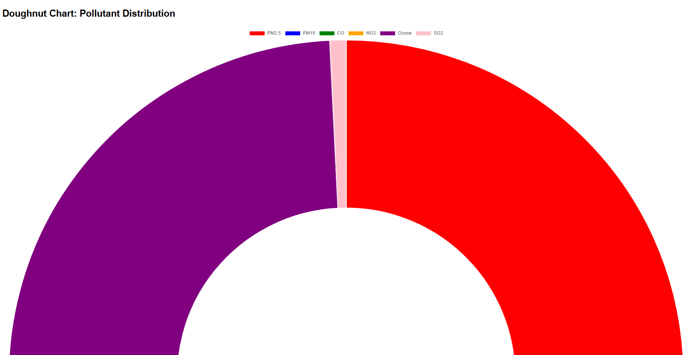
Doughnut Chart
Visualizes the distribution of PM2.5 and PM10 in total pollution.
Interactive and responsive.

Slide 10
What’s Missing and How to Complete It
Real-time Data for All Pollutants
Missing: Accurate data for NOx, NH3, CO2, SO2, and VOC.
How to Complete: Explore and integrate additional APIs (e.g., OpenAQ, Copernicus)
Historical Data for Charts
Missing: Accurate historical data for temperature, humidity, PM2.5, and PM10 over 12 months.
How to Complete:
Use simulated static data arrays for now.
Integrate a historical data API like IQAir's paid tier if feasible.
Dynamic Air Quality Indicators
Missing: Visual indicators (e.g., color-coded badges) to show the severity of air quality levels.
How to Complete: Use conditional logic in JavaScript to dynamically assign colors based on pollutant levels (e.g., green for good, red for poor).
Footer and Additional Sections
Missing: Footer with credits, API documentation links, and legal information.
How to Complete: Add a simple footer in the HTML layout with CSS styling for responsiveness.
Improved Responsiveness
Missing: Better support for mobile and tablet devices.
How to Complete: Use media queries in CSS to adapt the layout for different screen sizes.
Accessibility Enhancements
Missing: Alt text for images, ARIA roles, and semantic HTML for visually impaired users.
How to Complete: Add descriptive alt attributes for images and ARIA roles in the HTML.
Complete Documentation
Missing: A README file detailing setup, usage, and features.
How to Complete: Write a markdown file outlining project requirements, setup instructions, and API usage.

